Slide 1

Department of Computer Science and Engineering
TG
BANGALORE
MAJOR PROJECT
LEARNHUB ONLINE LEARNING PLATFORM
Ashwini(TG02CS0153)
Keerthi (TG02CS0151)
Nidhisha(TG02CS0150)
Guide:Mr.Likhith

Slide 2
•Abstract
•Introduction
•Objective
•Problem Definition
•Scope
•Methodology
•Experimental Setup
•Results or Findings
•Summary Table
•Discussion
•Proposed System
•Feasibility Study
•Workflow
•Methods and Techniques Used
•Progress in Project
•Results
•Conclusion
•References

Slide 3
ABSTRACT
Learn Hub is a comprehensive full-stack online learning platform developed using React.js for frontend, Node.js with Express.js for backend, and MySQL for database management. The platform provides secure user authentication, responsive UI design, role-based access control, and easy access to educational resources through an interactive and user-friendly interface.
The platform allows students to enroll in courses, watch video lessons, attempt quizzes, track learning progress, add courses . Instructors can create and manage courses, upload videos, create quizzes, and view student performance. Administrators have complete control to manage users, approve/reject courses, manage categories, remove inappropriate content, view analytics dashboards, and handle complaints.
The project demonstrates practical implementation of full-stack web development concepts including frontend-backend integration, REST API communication, MySQL database management, JWT authentication, role-based authorization, and deployment using Verel (frontend) and Render (backend).
.

Slide 4
INTRODUCTION
Online learning platforms have become essential in modern education, especially after the global shift toward digital learning. Traditional learning systems often lack flexibility, accessibility, and interactive features that modern students require.
Key Challenges in Traditional Systems:
Limited accessibility across devices
Lack of real-time interaction between students and instructors
No centralized platform for course management
Learn Hub - The Solution:
Provides organized and interactive learning environment
Includes features like authentication, dashboards, and course access
Designed using React.js + Node.js + Express.js + MySQL stack
Responsive interface supports mobile, tablet, and desktop devices
Benefits:
Helps users access educational content anytime, anywhere
Provides smooth navigation and better user experience
Improves practical understanding of full-stack web development
Supports digital learning and skill development
Makes learning resources easily accessible and manageable

Slide 5
Objectives
Primary Objectives:
To develop a responsive online learning platform using React.js, Node.js, Express.js, and MySQL
To provide secure login and registration functionality with JWT authentication
To create role-based dashboards for Students, Instructors, and Admins
To organize educational content effectively with course categorization
Secondary Objectives:
To improve accessibility for learners on different devices
To integrate frontend, backend, and database operations seamlessly
To implement secure authentication using JWT and crypt
To gain practical knowledge of full-stack web development
Enhanced Features Objectives:
To implement AI-based course recommendation system
To deploy the application using Verel and Render

Slide 6
Problem Definition
Many traditional learning systems lack proper organization, responsiveness, and interactive features. Students often face difficulties in accessing learning resources through a single platform..
Key problems identified include:
Accessibility Issues
Security Concerns
Progress Tracking
Our Solution: Learn Hub solves these problems by providing a centralized, responsive, and secure application with role-based access, real-time features, and comprehensive course management.

Slide 7
Scope of the Project
Core Features (Completed)
User registration and login system with JWT authentication
Role-based authorization (Student, Instructor, Admin)
Course access and management
Video learning modules for students
Online quizzes for knowledge assessment
Responsive dashboard for better user experience
Database integration using MySQL
REST API communication between frontend and backend
Course enrollment system

Slide 8
Technologies Used
Frontend
React.js
Tailwind CSS
React Router DOM
Backend
Node.js
Express.js
Database
MySQL
Tools
VS Code
GitHub
Deployment
Verel
Render

Slide 9
Methodology
Analysed requirements for Student, Instructor, and Admin roles
Identified core and enhanced features
Prepared SRS document
Designed system architecture and database schema
Created ER diagram and DFD diagrams
Planned API endpoints and data flow
Designed MySQL database with 12+ tables
Established table relationships and indexing
Created REST APIs using Node.js and Express.js
Implemented JWT authentication middleware
Built controllers for courses, quizzes
Developed responsive UI using React.js and Tailwind CSS
Implemented state management using React Context
Implemented protected routes for role-based access
Connected frontend with backend APIs
Performed unit and integration testing
Tested responsiveness across devices
Deployed frontend on Verel
Deployed backend on Render
Set up environment variables

Slide 10
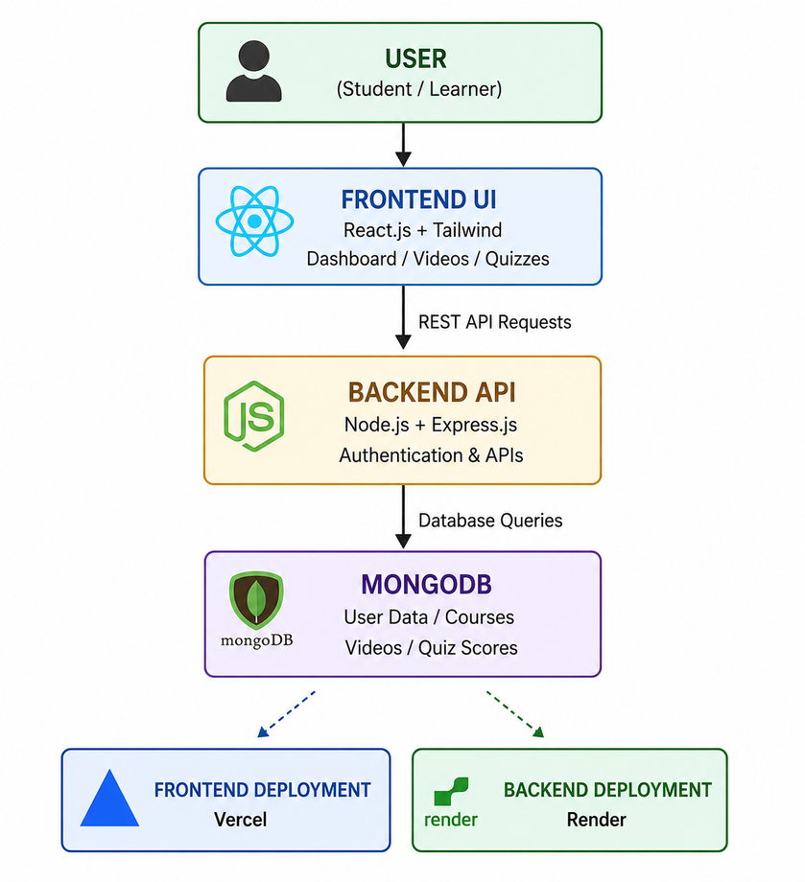
System Architecture
Users interact with the application through the frontend interface developed using React.js and Tailwind CSS.
The frontend sends API requests to the backend server.
The backend developed using Node.js and Express.js handles authentication, course management, quizzes, and videos.
MongoDB stores user details, course information, quiz results, and learning data.
The frontend is deployed on Verel and the backend is hosted on Render.

Slide 11
Features
System Features
JWT-based secure authentication system
Role-based access control (Student, Instructor, Admin)
REST API integration for frontend-backend communication
MySQL database connectivity for data storage
Secure password encryption using crypt
Protected routes for authorized access
Error handling and validation middleware
File upload support for course thumbnails
SQL injection prevention
Cross-origin resource sharing (CORS) enabled
Environment variable configuration
Deployment on Verel and Render
User Features
Register and login securely
Browse all available courses
View detailed course information
Enroll in free or paid courses
Watch video lessons
Attempt quizzes and get instant results
Track learning progress
View personal dashboard with analytics
Update profile information
Change password

Slide 12
Experimental Setup
React.js and Tailwind CSS used for frontend development
Node.js and Express.js used for backend API creation
MySQL used for database management
JWT authentication implemented for secure login
Video learning modules integrated into the system
Quiz functionality added for student assessment
Rating and review system for courses
Application tested on desktop and mobile devices
Browser compatibility checked using Chrome, Firefox, and Edge
API testing performed using Postman
Frontend deployed on Verel platform
Backend server hosted on Render platform
MySQL database hosted on cloud (Aiven/Cleaver)

Slide 13
Results / Findings
Responsive online learning platform developed successfully
Secure login and authentication system implemented using JWT
Role-based dashboards created for Students, Instructors, and Admins
Smooth frontend and backend communication achieved using REST APIs
Video learning modules working efficiently
Quiz functionality successfully integrated with auto-grading
MySQL database storing user, course, and quiz data properly
Fast loading speed and smooth navigation observed
User-friendly dashboard improved learning experience
Application tested successfully on desktop, tablet, and mobile devices
Browser compatibility verified on Chrome, Firefox, and Edge

Slide 14
Summary Table
Feature | Description | Result
User Authentication | Secure login and registration using JWT | Improved security
Role-based Dashboards | Separate dashboards for Student, Instructor, Admin | Better access control
Video Modules | Online video learning support | Easy understanding
Quiz System | Conducts quizzes and auto-grading | Knowledge evaluation
MySQL Database | Stores user, course, and quiz data | Efficient data management
REST APIs | Connects frontend and backend | Smooth communication
Responsive Design | Supports desktop, tablet, mobile | Better accessibility
Course Management | Create, edit, delete courses | Structured learning
Deployment | Hosted on Verel and Render | Live accessibility
Performance | Fast loading and smooth navigation | Improved efficiency

Slide 15
Discussion
The project successfully combines frontend, backend, and database technologies
React.js helped in creating reusable and responsive UI components
Node.js and Express.js improved backend API development
MySQL provided reliable and efficient data management
JWT authentication improved system security and user protection
Video learning modules enhanced interactive learning experience
Quiz functionality helped in student knowledge assessment
Responsive design improved accessibility across all devices
REST APIs ensured smooth communication between frontend and backend
Deployment using Verel and Render improved online accessibility
The application provides a scalable foundation for future enhancements
UI/UX design improved navigation and user interaction
Database integration helped manage users, courses, and quiz data efficiently
The system demonstrates real-world implementation of full-stack web development

Slide 16
Feasibility Study
The project is technically feasible using React.js, Node.js, Express.js, and MySQL technologies
React.js provides efficient frontend development support
Node.js and Express.js enable smooth backend API creation
MySQL supports reliable and secure database management
Open-source technologies reduce overall development cost
Free hosting platforms like Verel and Render improve economic feasibility
The system is easy to operate and user-friendly
Responsive design ensures accessibility across multiple devices
The project can be completed within the planned development timeline
The application supports future scalability and feature enhancements

Slide 17
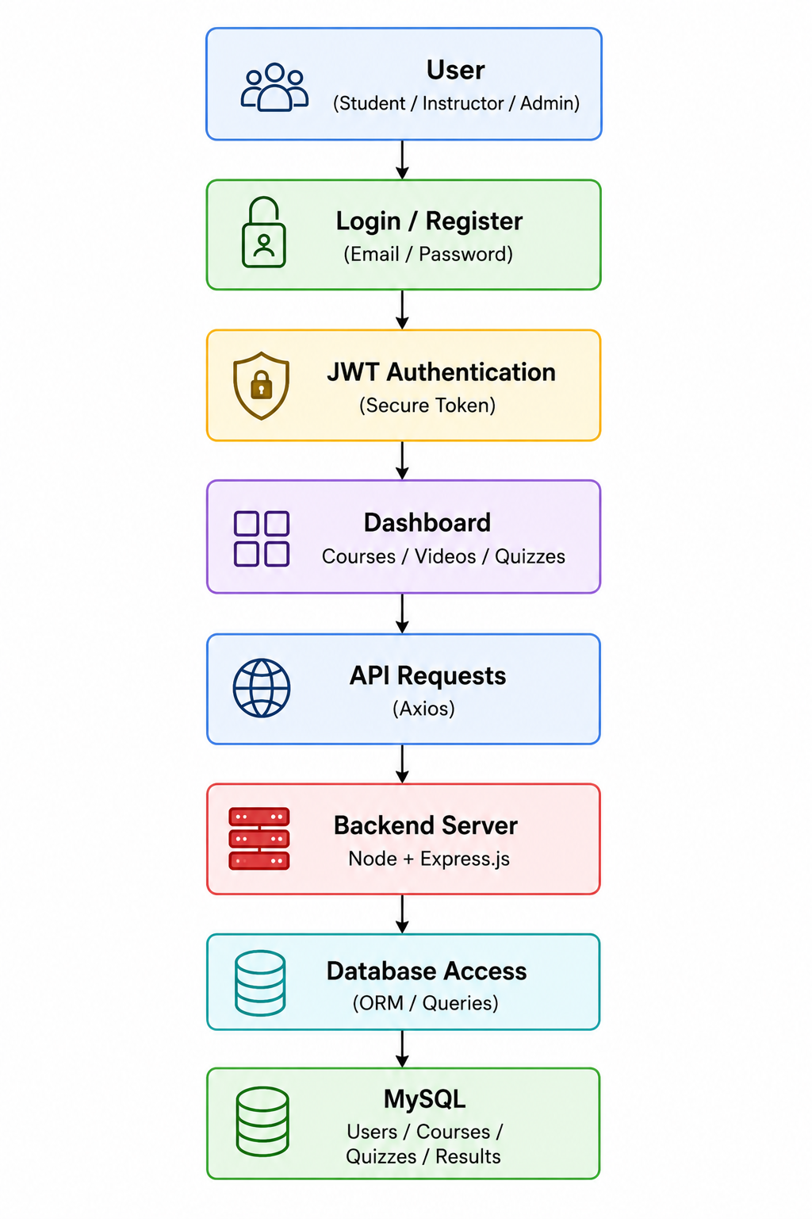
Workflow
User opens the Learn Hub application
User registers or logs into the system
Authentication is verified using JWT
Dashboard is displayed after successful login based on role (Student/Instructor/Admin)
User accesses courses, videos, and quizzes
Frontend sends API requests to backend server
Backend processes requests using Node.js and Express.js
MySQL stores and retrieves user, course, and quiz data
Quiz results and learning progress are updated
User receives smooth and responsive learning experience

Slide 18
Methods and Techniques Used
The workflow of the Learn Hub application starts when the user opens the application and performs registration or login using secure authentication. After successful JWT verification, the system grants access to the dashboard where users can explore courses, watch educational videos, attempt quizzes, track their learning progress, chat with instructors, and manage their courses.
The frontend interface developed using React.js and Tailwind CSS sends API requests to the backend server created with Node.js and Express.js. The backend processes user requests, handles authentication, manages course data, processes payments, enables real-time chat, and communicates with the MySQL database.
MySQL stores important information such as user details, course content, video modules, quiz scores and progress records. The system ensures smooth communication between frontend and backend through REST APIs, providing fast performance, secure access, and responsive user experience across all devices.

Slide 19
Progress in Project
Requirement analysis and project planning completed
Designed the UI layout and overall workflow of the application
Created responsive frontend using React.js and Tailwind CSS
Developed login and registration modules
Implemented JWT authentication for secure access
Created dashboards for Students, Instructors, and Admins
Developed backend APIs using Node.js and Express.js
Integrated MySQL database for data storage
Added video learning and quiz functionalities
Tested responsiveness, APIs, and database operations successfully
Deployed frontend on Verel platform
Deployed backend on Render platform

Slide 20
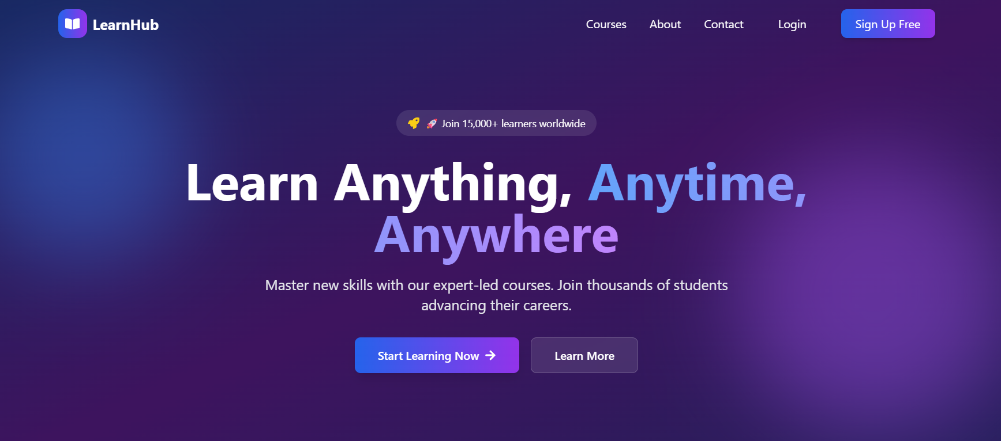
Results
Home page
The Home Page is the landing page of the Learn Hub Learning Application. It provides an introduction to the platform with attractive UI design and highlights important features such as online courses, expert instructors, and interactive quizzes. Users can browse available courses and access the sign-in page easily. The responsive design ensures smooth accessibility across different devices.

Slide 21
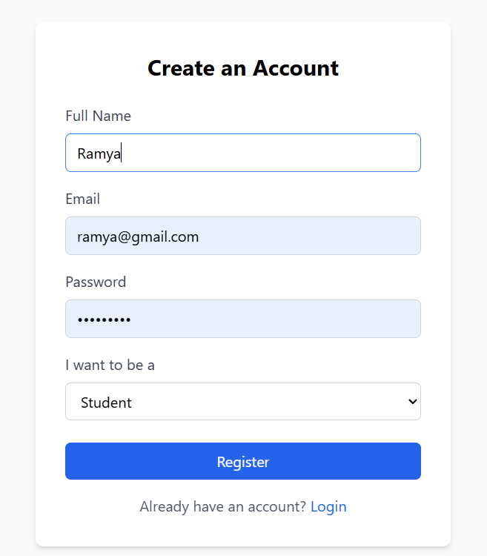
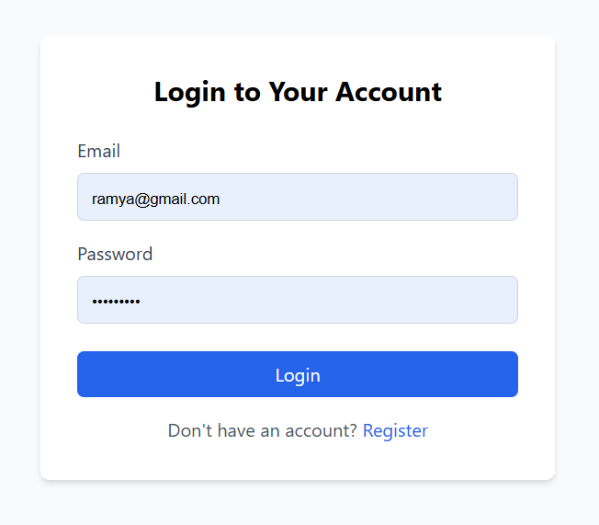
Registration Page
Login Page
The Registration Page allows new users to create an account on the Learn Hub platform. Users can register by entering their name, email address, password, and selecting their role as Student or Instructor. The system validates all inputs and securely stores user information in the MySQL database after password encryption using crypt.
The Login Page provides secure access to the Learn Hub platform. Registered users can log in using their email and password credentials. After successful JWT authentication, users are redirected to their respective dashboards based on their assigned roles (Student, Instructor, or Admin).

Slide 22
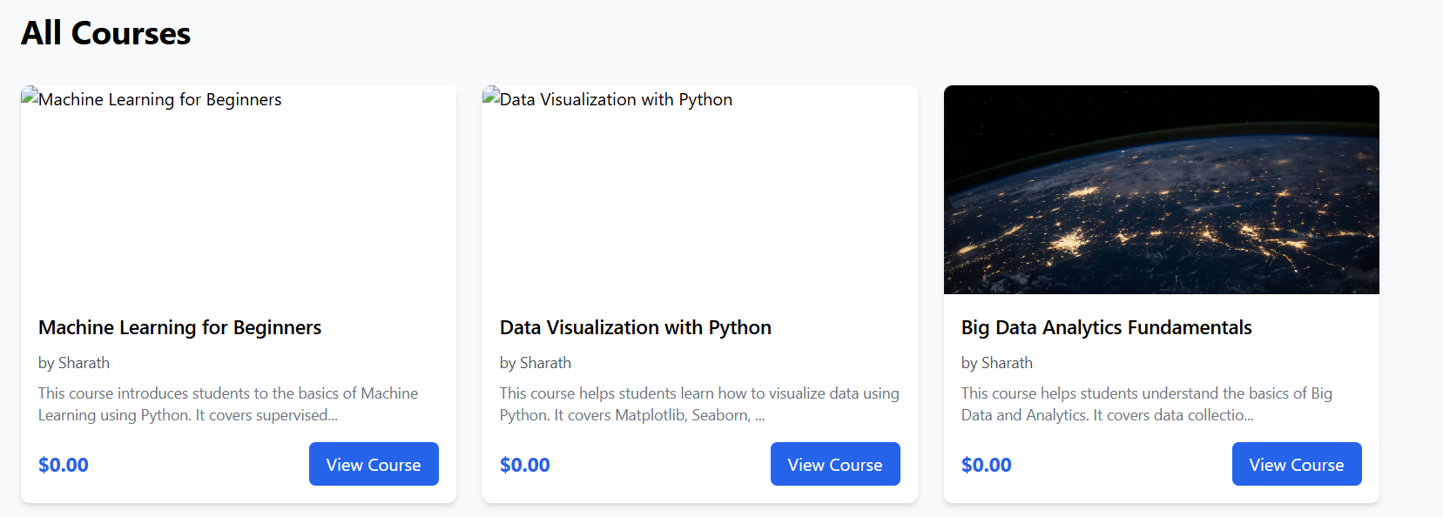
Featured Courses Page
The Featured Courses section displays various technical and professional courses available on the platform. Each course card contains course title, description, pricing, and enrollment options. This section helps learners explore courses such as AI, Web Development, Machine Learning, SQL, and Android Development etc...in an organized manner.

Slide 23
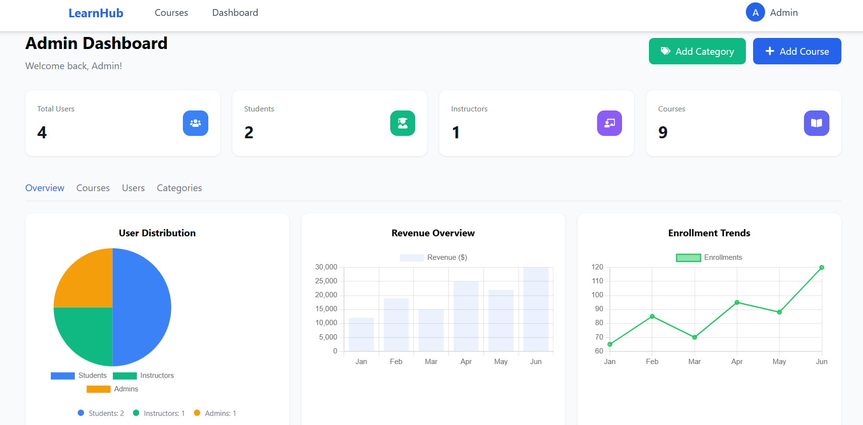
Admin Dashboard
The Admin Dashboard provides complete control over the learning platform. Admins can monitor total users, courses, students, and instructors. The dashboard also allows admins to approve or reject courses, manage categories, and view revenue reports.

Slide 24
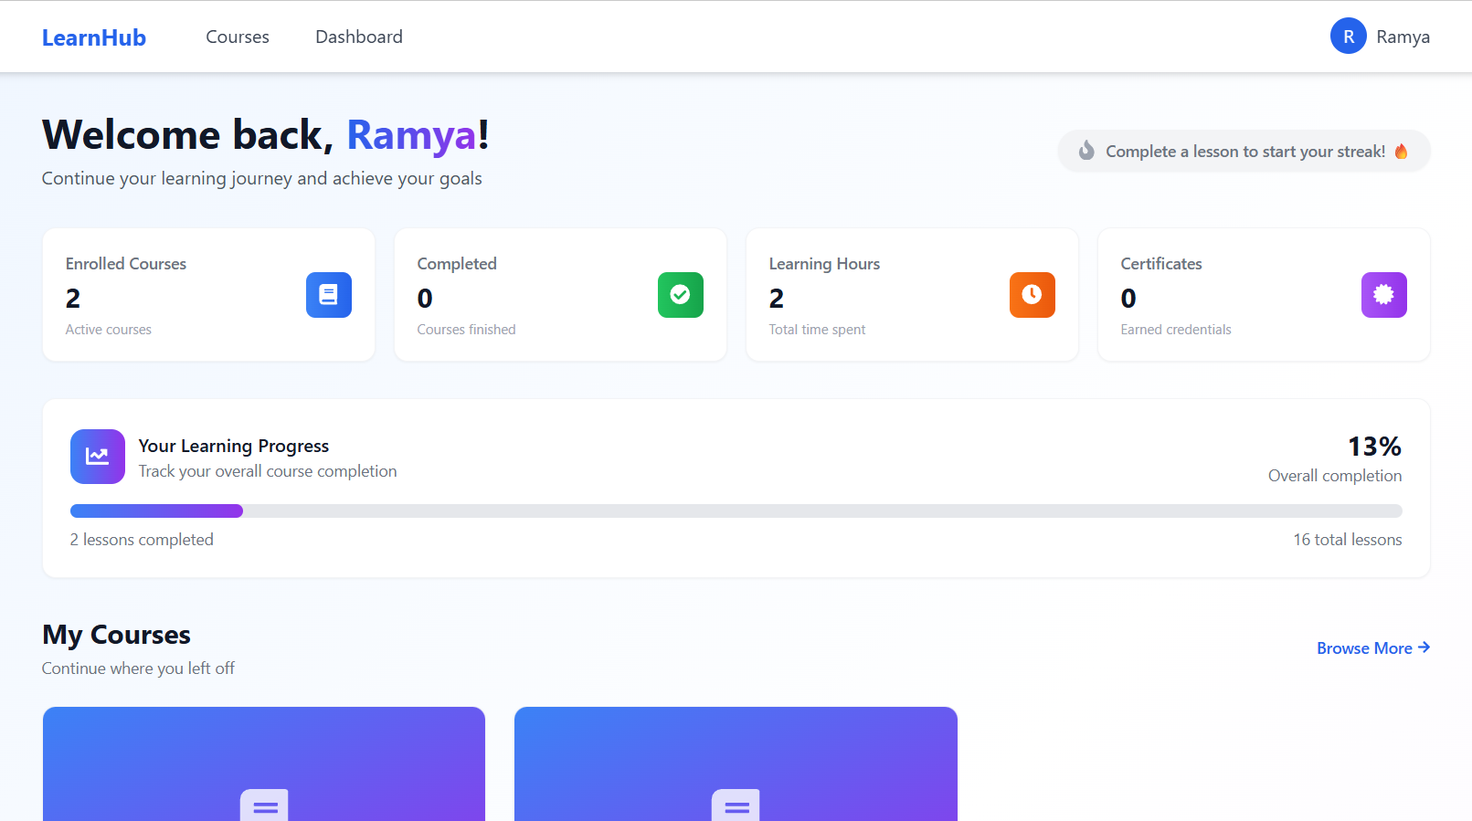
Student Dashboard
The Student Dashboard provides a personalized learning environment where students can access enrolled courses, track learning progress, watch videos, attempt quizzes, and view their quiz scores. The dashboard also displays recommended courses based on AI algorithms.

Slide 25
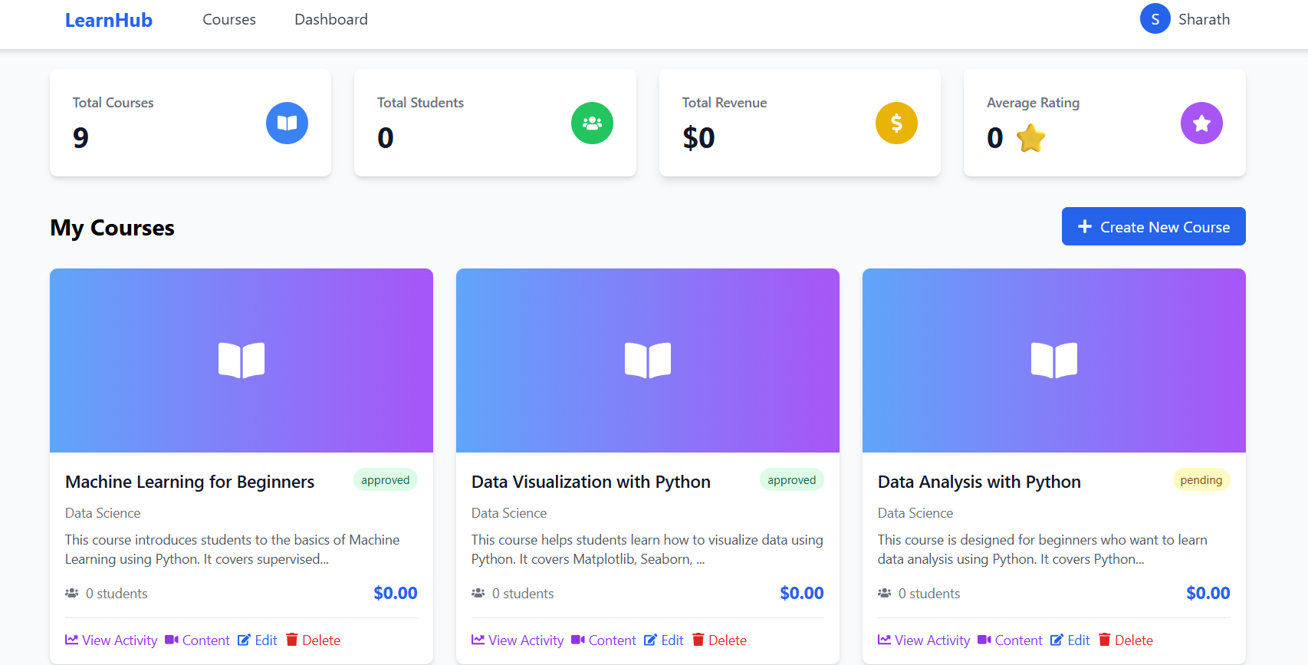
Instructor Course Management
The Instructor Dashboard allows instructors to create and manage courses. Instructors can add course titles, descriptions, pricing details, upload thumbnails, add video lessons, and create quizzes. Instructors can also view enrolled students and their performance.

Slide 26
Conclusion
The Learn Hub Learning Application successfully provides a responsive and secure online learning platform developed using React.js, Node.js, Express.js, and MySQL stack technologies. The project integrates features such as user authentication, course management, video learning, quizzes into a single system.
The application improves accessibility and provides a smooth learning experience through an interactive and user-friendly interface. It also enhanced practical understanding of frontend development, backend integration, database management, API communication, real-time features and deployment processes.
Overall, the project demonstrates effective implementation of full-stack web development concepts and supports future enhancements for advanced online learning systems.

Slide 27
References
React Documentation – Used for developing responsive frontend components and managing the user interface. Link: https://react.dev
Node.js Documentation – Referred for backend server development and API handling. Link: https://nodejs.org
Express.js Documentation – Used for creating REST APIs and backend routing functionality. Link: https://expressjs.com
MySQL Documentation – Helped in database integration and data management. Link: https://dev.mysql.com/doc
Tailwind CSS Documentation – Used for responsive UI design and frontend styling. Link: https://tailwindcss.com
W3Schools – Used for understanding frontend and backend development concepts with examples. Link: https://www.w3schools.com
Verel Documentation – Used for frontend deployment and hosting setup. Link: https://vercel.com
Render Documentation – Used for backend deployment and server hosting. Link: https://render.com
GitHub Documentation – Used for version control and project management. Link: https://docs.github.com
Postman Documentation – Used for API testing and documentation. Link: https://learning.postman.com
VS Code Documentation – Used as the primary IDE for development. Link: https://code.visualstudio.com/docs

Slide 28
THANK YOU

